Slide 1

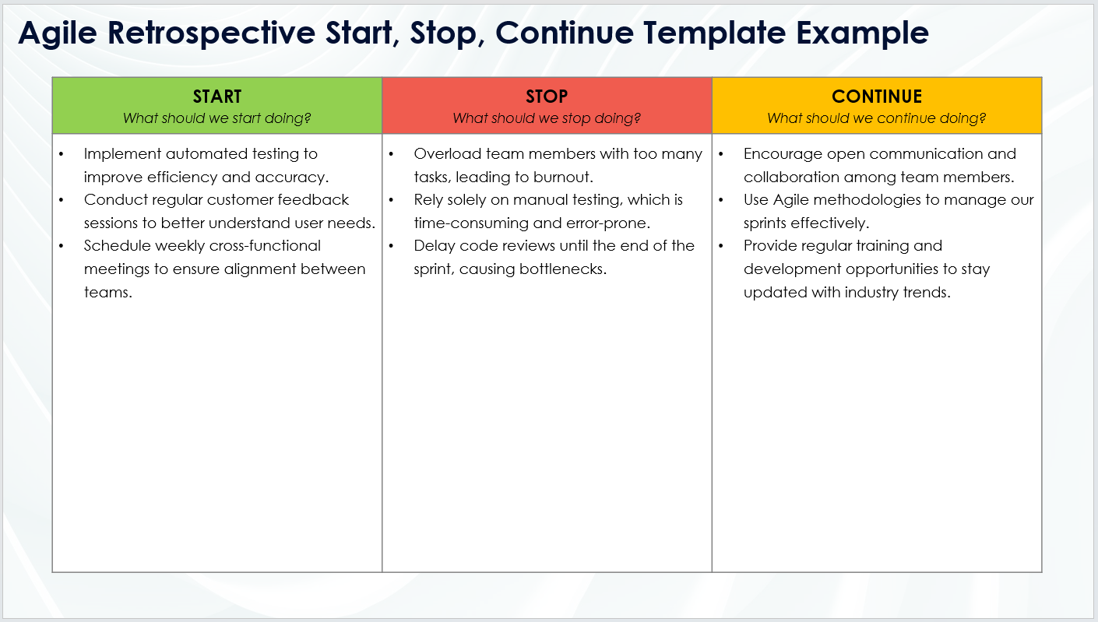
Agile Retrospective Start, Stop, Continue Template Example
When To Use This Template: Use this Agile retrospective start, stop, continue template during sprint retrospectives to discuss new actions to start, activities to stop, and practices to continue. It helps the team identify actionable steps for continuous improvement.
Notable Templates Features: This template includes three columns for easy Agile retrospectives: Start, Stop, and Continue, facilitating focused discussions on new initiatives, areas to cease, and ongoing practices that add value. This template promotes clear, actionable feedback and fosters team alignment on improvements.

Slide 2
Agile Retrospective Start, Stop, Continue Template Example
START What should we start doing? | STOP What should we stop doing? | CONTINUE What should we continue doing?
Implement automated testing to improve efficiency and accuracy. Conduct regular customer feedback sessions to better understand user needs. Schedule weekly cross-functional meetings to ensure alignment between teams. | Overload team members with too many tasks, leading to burnout. Rely solely on manual testing, which is time-consuming and error-prone. Delay code reviews until the end of the sprint, causing bottlenecks. | Encourage open communication and collaboration among team members. Use Agile methodologies to manage our sprints effectively. Provide regular training and development opportunities to stay updated with industry trends.

Slide 3
DISCLAIMER Any articles, templates, or information provided by Smartsheet on the website are for reference only. While we strive to keep the information up to date and correct, we make no representations or warranties of any kind, express or implied, about the completeness, accuracy, reliability, suitability, or availability with respect to the website or the information, articles, templates, or related graphics contained on the website. Any reliance you place on such information is therefore strictly at your own risk.

