Slide 1


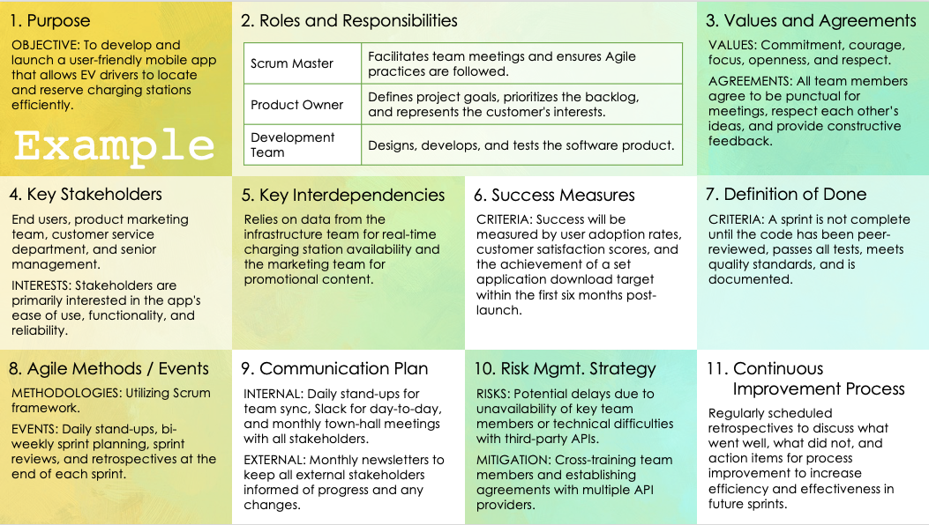
Agile Scrum Project Charter Template
When to Use This Template: Use this template to establish an Agile Scrum team to define roles, values, and success criteria. Doing so will help ensure clarity and alignment for effective Scrum practices.
Notable Template Features: This template includes sections for purpose, roles and responsibilities, Definition of Done, and Agile methods/events. This provides a structured framework to support Scrum processes and facilitate continuous improvement and effective communication within the team.

Slide 2

Blank / Instructional
1. Purpose
2. Roles and Responsibilities
3. Values and Agreements
Define the fundamental reason for the team's existence and what the project aims to achieve.
Scrum Master | Clearly delineate the roles within the Scrum team,
Product Owner | such as Scrum Master, Product Owner, and Developers,
Etc. | and describe the responsibilities associated with each role.
List the core values the team agrees to uphold (e.g., commitment, courage, focus, openness, and respect) and any team-specific agreements to enhance collaboration.
4. Key Stakeholders
5. Key Interdependencies
6. Success Measures
7. Definition of Done
Identify all critical stakeholders involved or affected by the project, outlining their interest and influence regarding the project's outcomes.
Describe essential dependencies between this team and other projects or organizational functions, including any external dependencies that could impact deliverables.
Define clear, specific, and measurable criteria for success to evaluate the project's progress and completion effectively.
Establish a shared understanding of what it means for work to be completed, including the necessary criteria that must be met to consider a product increment finished.
8. Agile Methods / Events
9. Communication Plan
10. Risk Mgmt. Strategy
11. Continuous Improvement Process
Specify the Agile methodologies (e.g., Scrum, Kanban) and key events (e.g., Daily Stand-ups, Sprint Planning, Reviews, and Retrospectives) the team will utilize during the project.
Outline how the team will communicate, detailing the channels, frequency, and formats used for communication within the team and with stakeholders.
Identify potential risks and the strategies for mitigating them, ensuring the team is prepared to handle uncertainties effectively.
Describe the process for regularly reviewing and improving the team’s workflow, techniques, and interactions to enhance productivity and product quality.

Slide 3
Blank
1. Purpose
2. Roles and Responsibilities
3. Values and Agreements
Text
Text
4. Key Stakeholders
5. Key Interdependencies
6. Success Measures
7. Definition of Done
Text
Text
Text
Text
8. Agile Methods / Events
9. Communication Plan
10. Risk Mgmt. Strategy
11. Continuous Improvement Process
Text
Text
Text
Text

Slide 4
Example
1. Purpose
2. Roles and Responsibilities
3. Values and Agreements
OBJECTIVE: To develop and launch a user-friendly mobile app that allows EV drivers to locate and reserve charging stations efficiently.
Scrum Master | Facilitates team meetings and ensures Agile practices are followed.
Product Owner | Defines project goals, prioritizes the backlog, and represents the customer's interests.
Development Team | Designs, develops, and tests the software product.
VALUES: Commitment, courage, focus, openness, and respect.
AGREEMENTS: All team members agree to be punctual for meetings, respect each other’s ideas, and provide constructive feedback.
Example
4. Key Stakeholders
5. Key Interdependencies
6. Success Measures
7. Definition of Done
End users, product marketing team, customer service department, and senior management.
INTERESTS: Stakeholders are primarily interested in the app's ease of use, functionality, and reliability.
Relies on data from the infrastructure team for real-time charging station availability and the marketing team for promotional content.
CRITERIA: Success will be measured by user adoption rates, customer satisfaction scores, and the achievement of a set application download target within the first six months post-launch.
CRITERIA: A sprint is not complete until the code has been peer-reviewed, passes all tests, meets quality standards, and is documented.
8. Agile Methods / Events
9. Communication Plan
10. Risk Mgmt. Strategy
11. Continuous Improvement Process
METHODOLOGIES: Utilizing Scrum framework.
EVENTS: Daily stand-ups, bi-weekly sprint planning, sprint reviews, and retrospectives at the end of each sprint.
INTERNAL: Daily stand-ups for team sync, Slack for day-to-day, and monthly town-hall meetings with all stakeholders.
EXTERNAL: Monthly newsletters to keep all external stakeholders informed of progress and any changes.
RISKS: Potential delays due to unavailability of key team members or technical difficulties with third-party APIs.
MITIGATION: Cross-training team members and establishing agreements with multiple API providers.
Regularly scheduled retrospectives to discuss what went well, what did not, and action items for process improvement to increase efficiency and effectiveness in future sprints.

Slide 5
DISCLAIMER Any articles, templates, or information provided by Smartsheet on the website are for reference only. While we strive to keep the information up to date and correct, we make no representations or warranties of any kind, express or implied, about the completeness, accuracy, reliability, suitability, or availability with respect to the website or the information, articles, templates, or related graphics contained on the website. Any reliance you place on such information is therefore strictly at your own risk.

