Slide 1

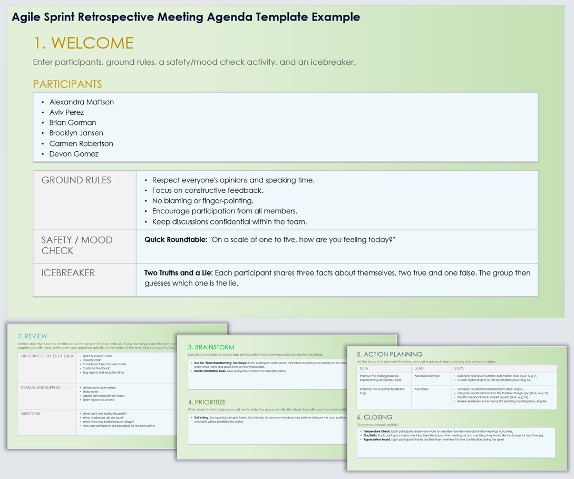
Agile Sprint Retrospective Meeting Agenda Template
When To Use This Template: Use this Agile sprint retrospective meeting agenda template to structure your sprint retrospective meetings. Doing so will help ensure that all participants engage and that the meeting covers essential topics like what went well, areas for improvement, brainstorming, and action planning.
Notable Templates Features: The template Includes sections for Welcome (including acknowledging Participants, Ground Rules, Safety/Mood Check, and playing an Icebreaker), a Review of the sprint, Brainstorming, a section to Prioritize ideas, Action Planning, and a meeting Closing activity.

Slide 2
Agile Sprint Retrospective Meeting Agenda Template
1. WELCOME
Enter participants, ground rules, a safety/mood check activity, and an icebreaker.
PARTICIPANTS
List participants
GROUND RULES | Enter ground rules
SAFETY / MOOD CHECK | Enter text
ICEBREAKER | Enter text

Slide 3
2. REVIEW
List the objective sources of data about the project that you will use. If you are using a specific format, list it here along with the supplies you will need. Write down any questions specific to the team or the work that you want to ask.
OBJECTIVE SOURCES OF DATA | Enter objective sources of data
FORMAT AND SUPPLIES | Enter formats and supplies
QUESTIONS | Enter questions

Slide 4
3. BRAINSTORM
Describe your plan to encourage participation from everyone and generate new ideas.
Enter text
4. PRIORITIZE
Write down the technique you will use to help the group identify the ideas that will have the most positive impact.
Enter text

Slide 5
5. ACTION PLANNING
List the steps to implement the idea, who will lead each step, and any due or target dates.
IDEA | LEAD | STEPS
Enter idea | Enter lead | Enter steps
Enter idea | Enter lead | Enter steps
6. CLOSING
Choose a closeout activity.
Enter text

Slide 6
DISCLAIMER Any articles, templates, or information provided by Smartsheet on the website are for reference only. While we strive to keep the information up to date and correct, we make no representations or warranties of any kind, express or implied, about the completeness, accuracy, reliability, suitability, or availability with respect to the website or the information, articles, templates, or related graphics contained on the website. Any reliance you place on such information is therefore strictly at your own risk.

