Slide 1


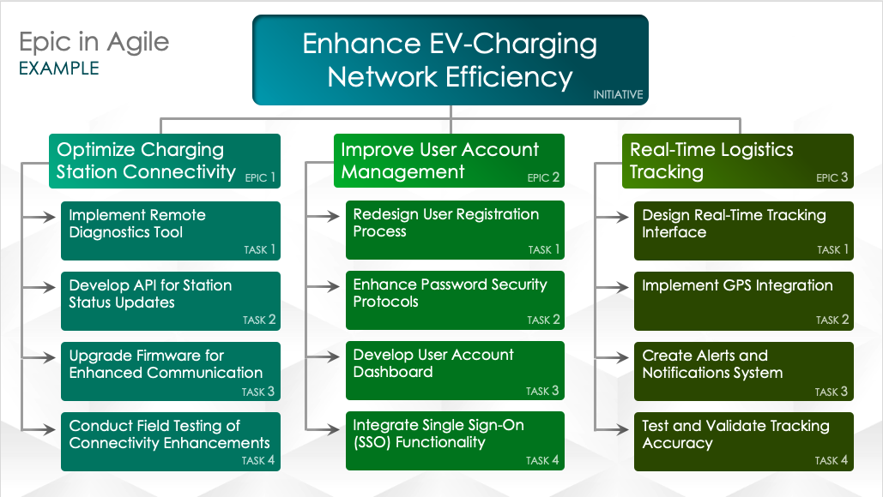
Basic Agile Epic Slide Template
When to Use This Template: Use this basic Agile epic slide template to organize the primary themes of a project, detailing its epics and their associated tasks or user stories. The template is particularly helpful for planning and communicating a project’s scope.
Notable Template Features: Available in a blank version or with example text, this presentation-ready template includes sections for overarching project themes, epic names, and related tasks or user stories. This layout allows you to clearly outline and easily access all key project elements.

Slide 2

Initiative Title
Epic in Agile
INITIATIVE
Text
Text
Text
EPIC 1
EPIC 2
EPIC 3
Text
Text
Text
TASK 1
TASK 1
TASK 1
Text
Text
Text
TASK 2
TASK 2
TASK 2
Text
Text
Text
TASK 3
TASK 3
TASK 3
Text
Text
Text
TASK 4
TASK 4
TASK 4

Slide 3
Initiative description
Epic in Agile
DESCRIPTIONS
INITIATIVE
EPIC 1: Description
EPIC 2: Description
EPIC 3: Description
Description
Description
Description
TASK 1
TASK 1
TASK 1
Description
Description
Description
TASK 2
TASK 2
TASK 2
Description
Description
Description
TASK 3
TASK 3
TASK 3
Description
Description
Description
TASK 4
TASK 4
TASK 4

Slide 4
DISCLAIMER Any articles, templates, or information provided by Smartsheet on the website are for reference only. While we strive to keep the information up to date and correct, we make no representations or warranties of any kind, express or implied, about the completeness, accuracy, reliability, suitability, or availability with respect to the website or the information, articles, templates, or related graphics contained on the website. Any reliance you place on such information is therefore strictly at your own risk.

