Slide 1


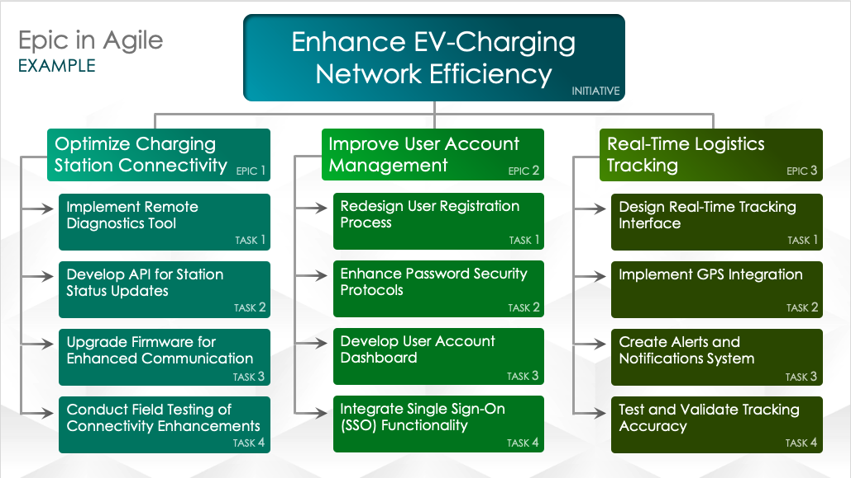
Basic Agile Epic Slide Template – Example
When to Use This Template: Use this basic Agile epic slide template to organize the primary themes of a project, detailing its epics and their associated tasks or user stories. The template is particularly helpful for planning and communicating a project’s scope.
Notable Template Features: Available in a blank version or with example text, this presentation-ready template includes sections for overarching project themes, epic names, and related tasks or user stories. This layout allows you to clearly outline and easily access all key project elements.
FPO

Slide 2

Enhance EV-Charging Network Efficiency
Epic in Agile
EXAMPLE
INITIATIVE
Optimize Charging Station Connectivity
Improve User Account Management
Real-Time Logistics Tracking
EPIC 1
EPIC 2
EPIC 3
Implement Remote Diagnostics Tool
Redesign User Registration Process
Design Real-Time Tracking Interface
TASK 1
TASK 1
TASK 1
Develop API for Station Status Updates
Enhance Password Security Protocols
Implement GPS Integration
TASK 2
TASK 2
TASK 2
Upgrade Firmware for Enhanced Communication
Develop User Account Dashboard
Create Alerts and Notifications System
TASK 3
TASK 3
TASK 3
Conduct Field Testing of Connectivity Enhancements
Integrate Single Sign-On (SSO) Functionality
Test and Validate Tracking Accuracy
TASK 4
TASK 4
TASK 4

Slide 3
Improve the efficiency and user experience of the Positive Charge EV-charging network through a series of targeted software updates and new features.
Epic in Agile
DESCRIPTIONS
EXAMPLE
INITIATIVE
EPIC 1: Enhance the connectivity and communication between EV-charging stations and the central management system to ensure real-time status updates and remote management capabilities.
EPIC 2: Upgrade the user account management system to provide a more seamless and secure experience for users, including new features for account creation, login, and management.
EPIC 3: Introduce a real-time logistics tracking feature to monitor the movement and status of EVs within the network, providing valuable insights for both users and administrators.
Create an API to facilitate real-time status updates from charging stations.
Simplify and streamline the user registration process.
Develop an interface to display real-time location and status of EVs.
TASK 1
TASK 1
TASK 1
Develop a tool to remotely diagnose and troubleshoot charging station issues.
Implement stronger password security measures and two-factor authentication.
Integrate GPS technology to accurately track vehicle locations.
TASK 2
TASK 2
TASK 2
Roll out a firmware upgrade for all stations to improve data transmission.
Create a user-friendly dashboard for managing account settings and preferences.
Set up a system to send alerts and notifications based on predefined events (e.g., low battery, route deviations).
TASK 3
TASK 3
TASK 3
Perform field tests to validate the improvements in station connectivity.
Implement SSO to allow users to log in using their existing social media or email accounts.
Perform extensive testing to ensure the accuracy and reliability of the tracking system.
TASK 4
TASK 4
TASK 4

Slide 4
Initiative Title
Epic in Agile
INITIATIVE
Text
Text
Text
EPIC 1
EPIC 2
EPIC 3
Text
Text
Text
TASK 1
TASK 1
TASK 1
Text
Text
Text
TASK 2
TASK 2
TASK 2
Text
Text
Text
TASK 3
TASK 3
TASK 3
Text
Text
Text
TASK 4
TASK 4
TASK 4

Slide 5
Initiative description
Epic in Agile
DESCRIPTIONS
INITIATIVE
EPIC 1: Description
EPIC 2: Description
EPIC 3: Description
Description
Description
Description
TASK 1
TASK 1
TASK 1
Description
Description
Description
TASK 2
TASK 2
TASK 2
Description
Description
Description
TASK 3
TASK 3
TASK 3
Description
Description
Description
TASK 4
TASK 4
TASK 4

Slide 6
DISCLAIMER Any articles, templates, or information provided by Smartsheet on the website are for reference only. While we strive to keep the information up to date and correct, we make no representations or warranties of any kind, express or implied, about the completeness, accuracy, reliability, suitability, or availability with respect to the website or the information, articles, templates, or related graphics contained on the website. Any reliance you place on such information is therefore strictly at your own risk.

