Slide 1

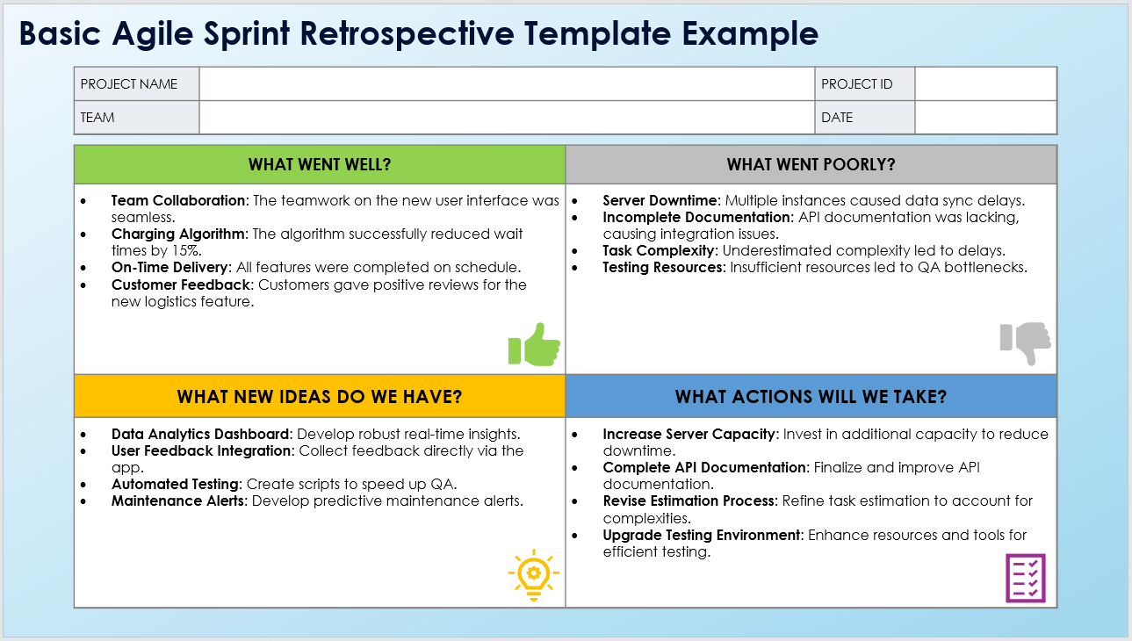
Basic Agile Sprint Retrospective Template
When To Use This Template: Use this basic Agile sprint retrospective template at the end of each sprint to reflect on what went well, identify areas for improvement, brainstorm new ideas, and plan actionable steps for the next sprint.
Notable Templates Features: This template includes sections for What Went Well? (thumbs up), What Went Poorly? (thumbs down), What New Ideas Do We Have? (lightbulb icon), and What Actions Will We Take? (list icon). This template is suitable for universal Agile practices across all formats.

Slide 2




Basic Agile Sprint Retrospective Template
PROJECT NAME |  | PROJECT ID
TEAM |  | DATE
WHAT WENT WELL? | WHAT WENT POORLY?
WHAT NEW IDEAS DO WE HAVE? | WHAT ACTIONS WILL WE TAKE?

Slide 3
DISCLAIMER Any articles, templates, or information provided by Smartsheet on the website are for reference only. While we strive to keep the information up to date and correct, we make no representations or warranties of any kind, express or implied, about the completeness, accuracy, reliability, suitability, or availability with respect to the website or the information, articles, templates, or related graphics contained on the website. Any reliance you place on such information is therefore strictly at your own risk.

