Slide 1


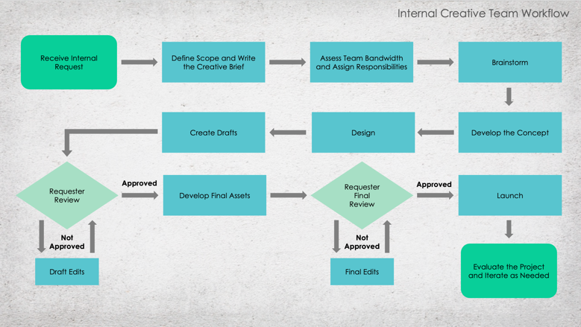
Internal Creative Team
Workflow Template

Slide 2
Internal Creative Team Workflow
Receive Internal Request
Define Scope and Write the Creative Brief
Assess Team Bandwidth and Assign Responsibilities
Brainstorm
Create Drafts
Design
Develop the Concept
Requester Review
Requester Final Review
Approved
Develop Final Assets
Approved
Launch
Not Approved
Not Approved
Evaluate the Project and Iterate as Needed
Draft Edits
Final Edits

Slide 3
DISCLAIMER Any articles, templates, or information provided by Smartsheet on the website are for reference only. While we strive to keep the information up to date and correct, we make no representations or warranties of any kind, express or implied, about the completeness, accuracy, reliability, suitability, or availability with respect to the website or the information, articles, templates, or related graphics contained on the website. Any reliance you place on such information is therefore strictly at your own risk.

