Slide 1

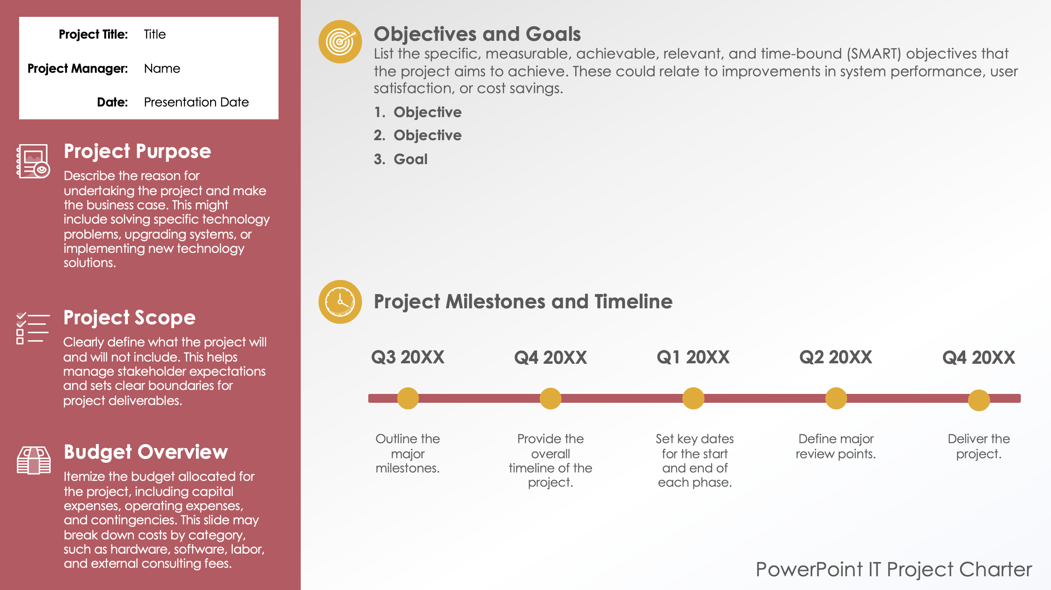
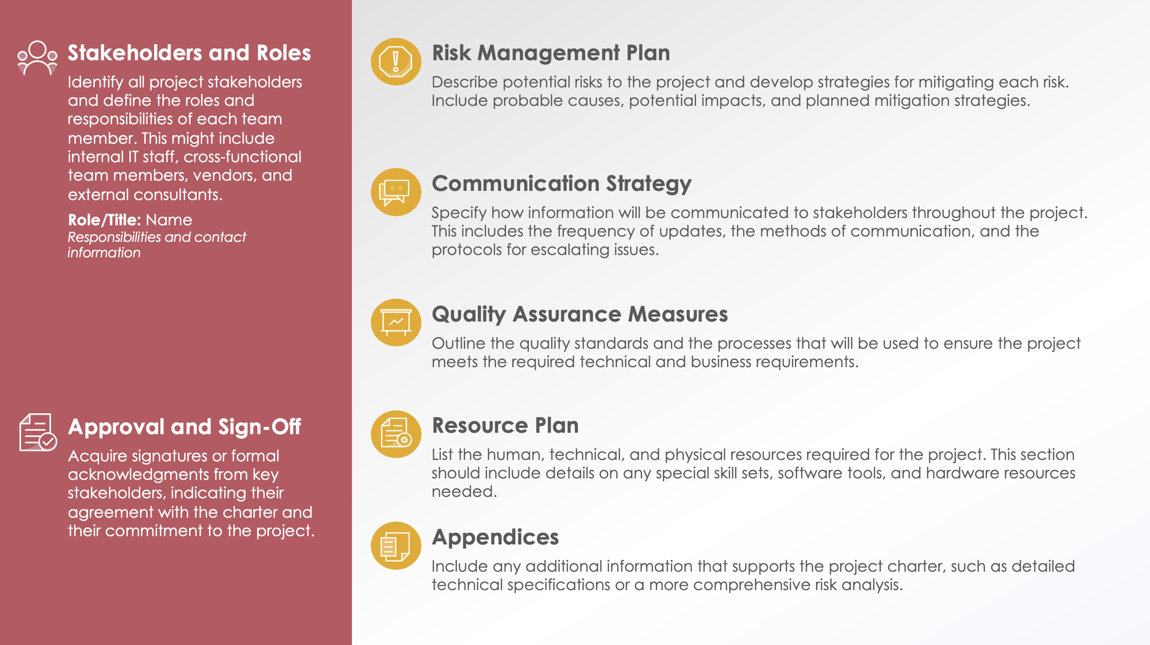
PowerPoint IT Project Charter Template

Slide 2





Project Title: | Title
Project Manager: | Name
Date: | Presentation Date
Objectives and Goals
List the specific, measurable, achievable, relevant, and time-bound (SMART) objectives that the project aims to achieve. These could relate to improvements in system performance, user satisfaction, or cost savings.
Objective
Objective
Goal
Project Purpose
Describe the reason for undertaking the project and make the business case. This might include solving specific technology problems, upgrading systems, or implementing new technology solutions.
Project Milestones and Timeline
Project Scope
Clearly define what the project will and will not include. This helps manage stakeholder expectations and sets clear boundaries for project deliverables.
Q3 20XX
Q4 20XX
Q1 20XX
Q2 20XX
Q4 20XX
Budget Overview
Itemize the budget allocated for the project, including capital expenses, operating expenses, and contingencies. This slide may break down costs by category, such as hardware, software, labor, and external consulting fees.
Outline the major milestones.
Provide the overall timeline of the project.
Set key dates for the start and end of each phase.
Define major review points.
Deliver the project.
PowerPoint IT Project Charter

Slide 3







Stakeholders and Roles
Identify all project stakeholders and define the roles and responsibilities of each team member. This might include internal IT staff, cross-functional team members, vendors, and external consultants.
Role/Title: Name
Responsibilities and contact information
Risk Management Plan
Describe potential risks to the project and develop strategies for mitigating each risk. Include probable causes, potential impacts, and planned mitigation strategies.
Communication Strategy
Specify how information will be communicated to stakeholders throughout the project. This includes the frequency of updates, the methods of communication, and the protocols for escalating issues.
Quality Assurance Measures
Outline the quality standards and the processes that will be used to ensure the project meets the required technical and business requirements.
Approval and Sign-Off
Acquire signatures or formal acknowledgments from key stakeholders, indicating their agreement with the charter and their commitment to the project.
Resource Plan
List the human, technical, and physical resources required for the project. This section should include details on any special skill sets, software tools, and hardware resources needed.
Appendices
Include any additional information that supports the project charter, such as detailed technical specifications or a more comprehensive risk analysis.

Slide 4
DISCLAIMER Any articles, templates, or information provided by Smartsheet on the website are for reference only. While we strive to keep the information up to date and correct, we make no representations or warranties of any kind, express or implied, about the completeness, accuracy, reliability, suitability, or availability with respect to the website or the information, articles, templates, or related graphics contained on the website. Any reliance you place on such information is therefore strictly at your own risk.

