Slide 1


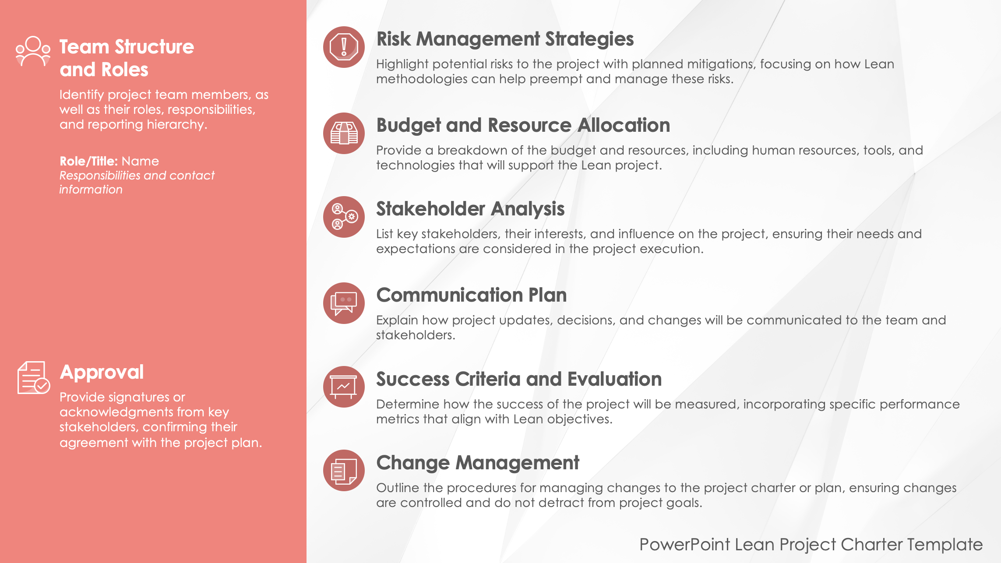
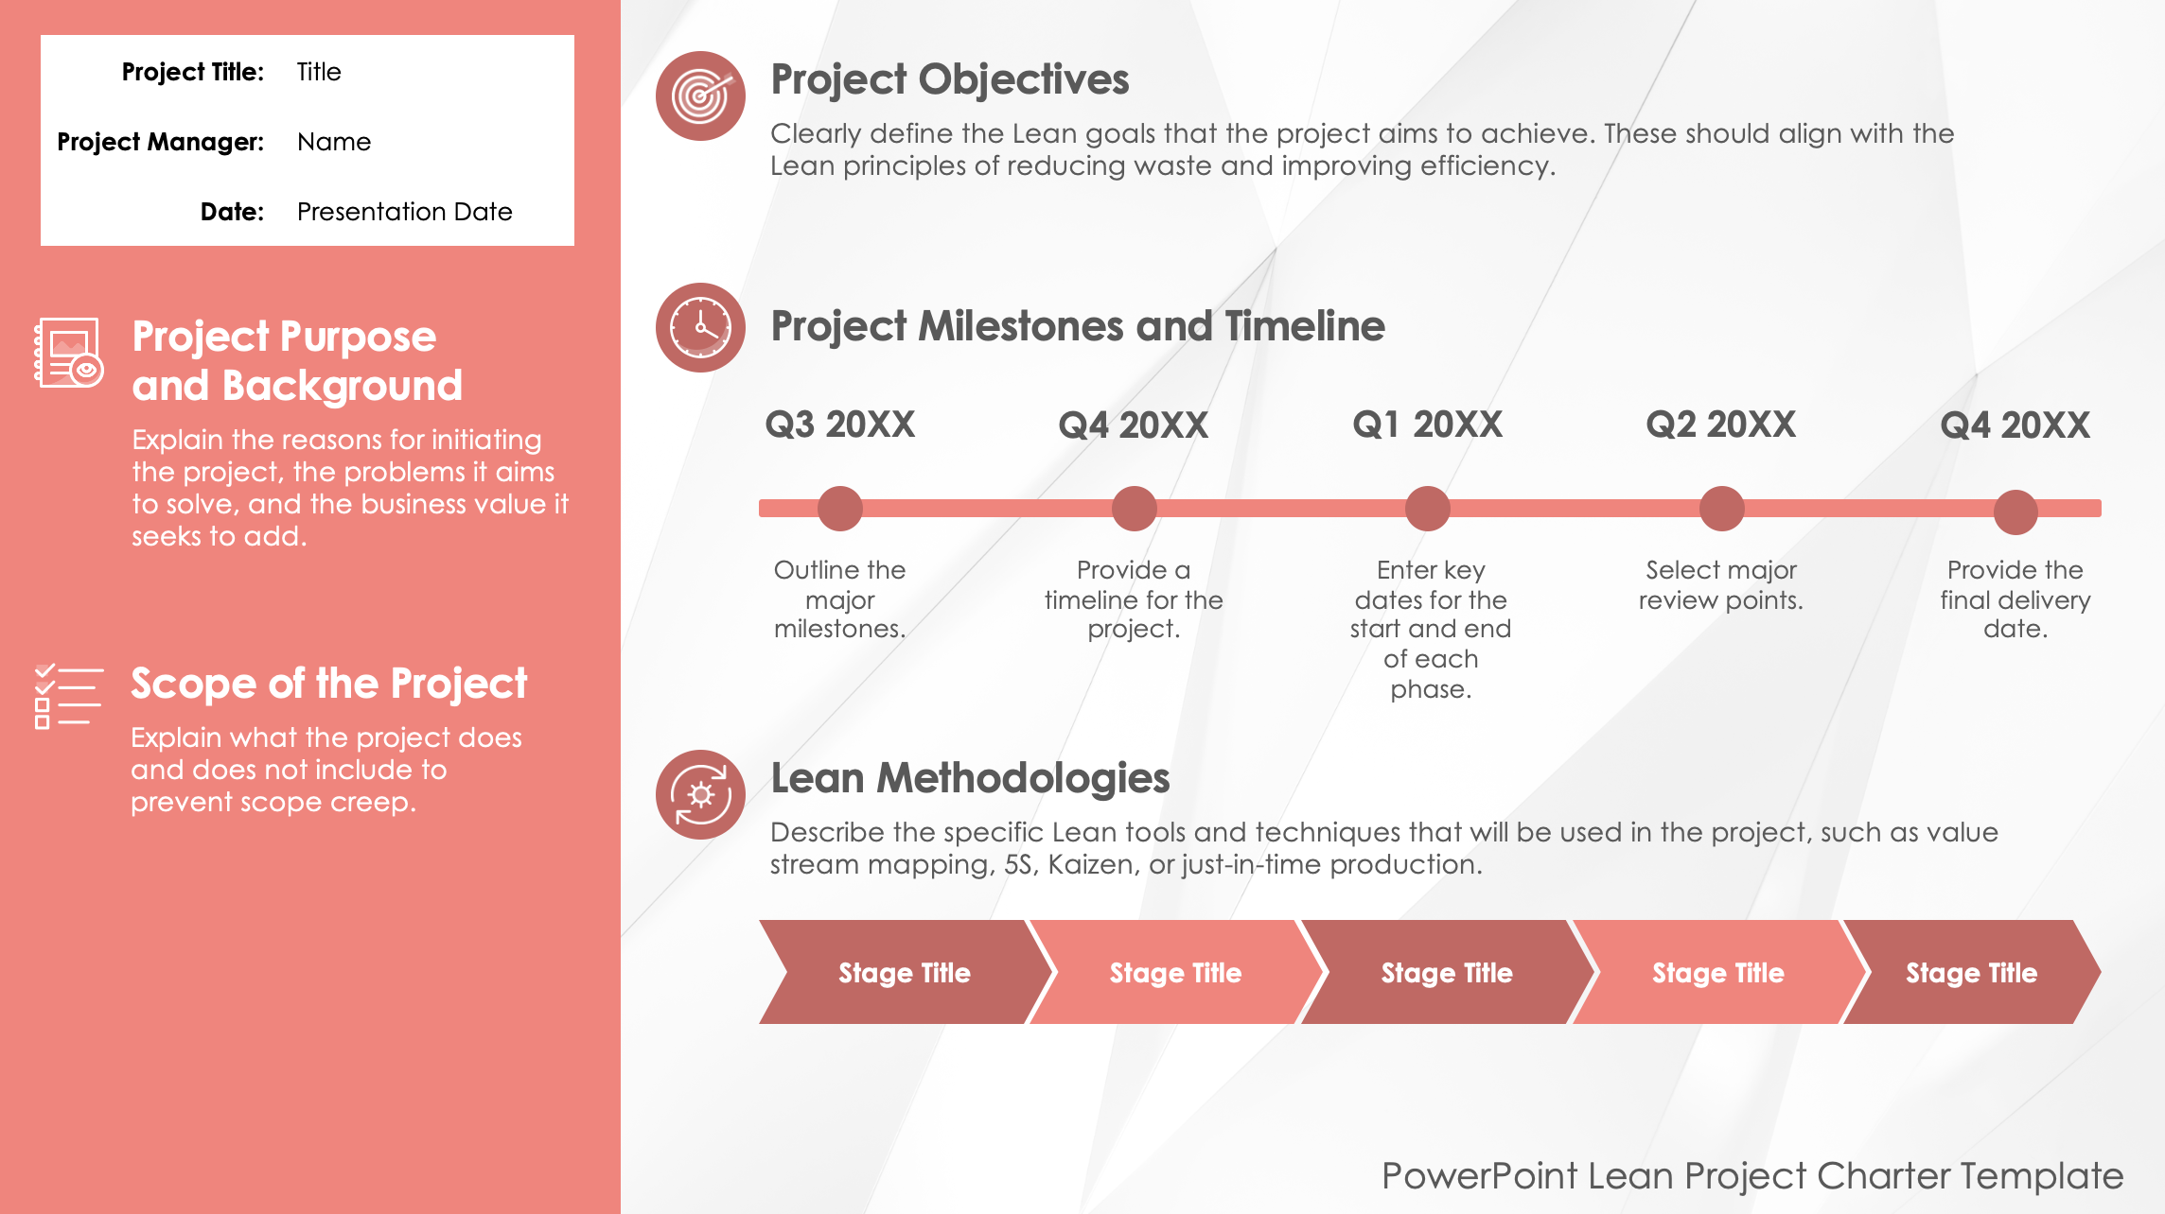
PowerPoint Lean Project Charter Template

Slide 2





Project Title: | Title
Project Manager: | Name
Date: | Presentation Date
Project Objectives
Clearly define the Lean goals that the project aims to achieve. These should align with the Lean principles of reducing waste and improving efficiency.
Project Purpose and Background
Explain the reasons for initiating the project, the problems it aims to solve, and the business value it seeks to add.
Project Milestones and Timeline
Q3 20XX
Q4 20XX
Q1 20XX
Q2 20XX
Q4 20XX
Outline the major milestones.
Provide a timeline for the project.
Enter key dates for the start and end of each phase.
Select major review points.
Provide the final delivery date.
Scope of the Project
Explain what the project does and does not include to prevent scope creep.
Lean Methodologies
Describe the specific Lean tools and techniques that will be used in the project, such as value stream mapping, 5S, Kaizen, or just-in-time production.
Stage Title
Stage Title
Stage Title
Stage Title
Stage Title
PowerPoint Lean Project Charter Template

Slide 3








Team Structure and Roles
Identify project team members, as well as their roles, responsibilities, and reporting hierarchy.
Role/Title: Name Responsibilities and contact information
Risk Management Strategies
Highlight potential risks to the project with planned mitigations, focusing on how Lean methodologies can help preempt and manage these risks.
Budget and Resource Allocation
Provide a breakdown of the budget and resources, including human resources, tools, and technologies that will support the Lean project.
Stakeholder Analysis
List key stakeholders, their interests, and influence on the project, ensuring their needs and expectations are considered in the project execution.
Communication Plan
Explain how project updates, decisions, and changes will be communicated to the team and stakeholders.
Approval
Provide signatures or acknowledgments from key stakeholders, confirming their agreement with the project plan.
Success Criteria and Evaluation
Determine how the success of the project will be measured, incorporating specific performance metrics that align with Lean objectives.
Change Management
Outline the procedures for managing changes to the project charter or plan, ensuring changes are controlled and do not detract from project goals.
PowerPoint Lean Project Charter Template

Slide 4
DISCLAIMER Any articles, templates, or information provided by Smartsheet on the website are for reference only. While we strive to keep the information up to date and correct, we make no representations or warranties of any kind, express or implied, about the completeness, accuracy, reliability, suitability, or availability with respect to the website or the information, articles, templates, or related graphics contained on the website. Any reliance you place on such information is therefore strictly at your own risk.

