Slide 1

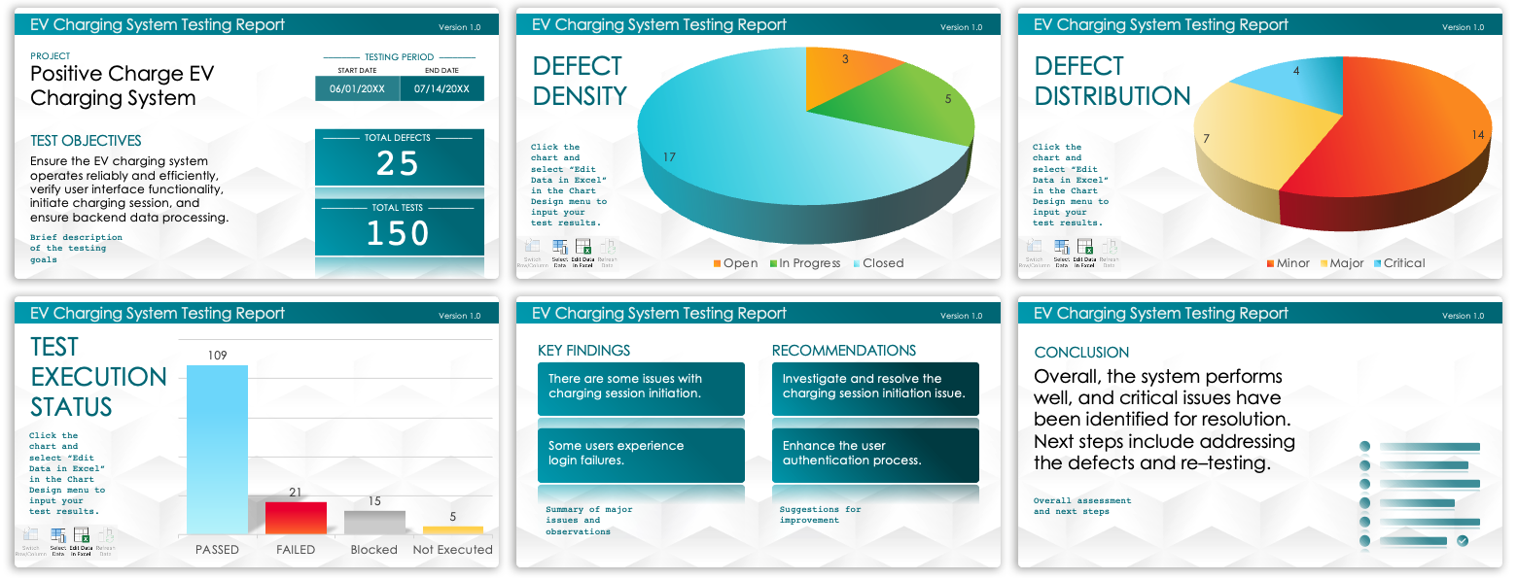
Agile Test Summary Report Template – Example
When to Use This Template: Use this Agile test summary report template when your project would benefit from a visually rich, dashboard-style overview of all testing activities. You can use this template to quickly communicate the status and results of the testing phase to stakeholders.
Notable Template Features: This template includes a variety of charts and graphs, such as defect density and test execution status, which provide a clear visual representation of key metrics. It also includes sections to summarize tests and defects.

Slide 2
EV Charging System Testing Report
Version 1.0
PROJECT
–––––––– TESTING PERIOD ––––––––
START DATE | END DATE
06/01/20XX | 07/14/20XX
Positive Charge EV Charging System
TEST OBJECTIVES
–––––––– TOTAL DEFECTS ––––––––
25
Ensure the EV charging system operates reliably and efficiently, verify user interface functionality, initiate charging session, and ensure backend data processing.
–––––––––– TOTAL TESTS ––––––––––
150
Brief description of the testing goals

Slide 3

EV Charging System Testing Report
Version 1.0
DEFECT DENSITY
Click the chart and select “Edit Data in Excel” in the Chart Design menu to input your test results.

Slide 4
EV Charging System Testing Report
Version 1.0
DEFECT DISTRIBUTION
Click the chart and select “Edit Data in Excel” in the Chart Design menu to input your test results.

Slide 5
EV Charging System Testing Report
Version 1.0
TEST EXECUTION STATUS
Click the chart and select “Edit Data in Excel” in the Chart Design menu to input your test results.

Slide 6
EV Charging System Testing Report
Version 1.0
KEY FINDINGS
RECOMMENDATIONS
There are some issues with charging session initiation.
Investigate and resolve the charging session initiation issue.
Some users experience login failures.
Enhance the user authentication process.
Summary of major issues and observations
Suggestions for improvement

Slide 7
EV Charging System Testing Report
Version 1.0
CONCLUSION
Overall, the system performs well, and critical issues have been identified for resolution. Next steps include addressing the defects and re–testing.
Overall assessment and next steps

Slide 8
DISCLAIMER Any articles, templates, or information provided by Smartsheet on the website are for reference only. While we strive to keep the information up to date and correct, we make no representations or warranties of any kind, express or implied, about the completeness, accuracy, reliability, suitability, or availability with respect to the website or the information, articles, templates, or related graphics contained on the website. Any reliance you place on such information is therefore strictly at your own risk.

