Slide 1


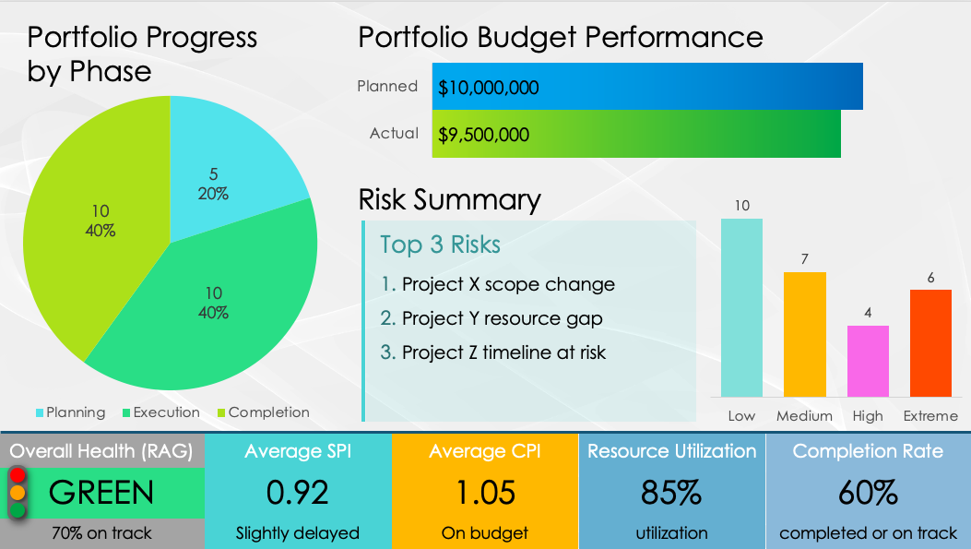
Performance-Based Project Portfolio Dashboard Template

Slide 2
Portfolio Progress by Phase
Portfolio Budget Performance
Risk Summary
Top 3 Risks
Project X scope change
Project Y resource gap
Project Z timeline at risk
Overall Health (RAG)
GREEN
70% on track
Average SPI
0.92
Slightly delayed
Average CPI
1.05
On budget
Resource Utilization
85%
utilization
Completion Rate
60%
completed or on track

Slide 3
DISCLAIMER Any articles, templates, or information provided by Smartsheet on the website are for reference only. While we strive to keep the information up to date and correct, we make no representations or warranties of any kind, express or implied, about the completeness, accuracy, reliability, suitability, or availability with respect to the website or the information, articles, templates, or related graphics contained on the website. Any reliance you place on such information is therefore strictly at your own risk.

