Slide 1

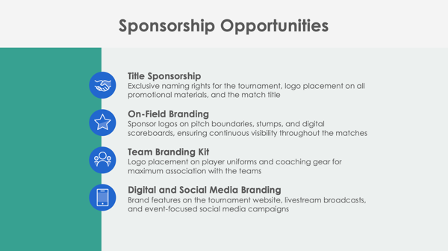
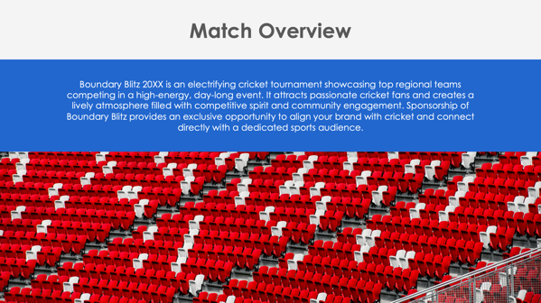
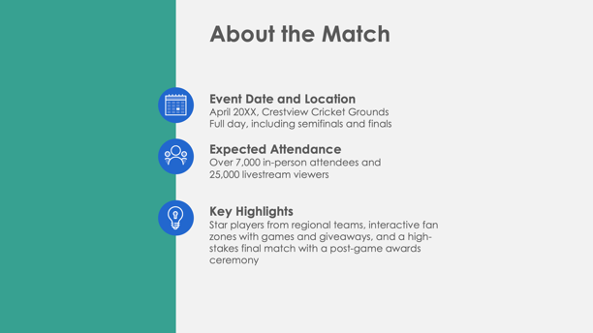

PowerPoint Cricket Sponsorship Proposal Template Example

Slide 2

Boundary Blitz 20XX: The Premier Cricket Tournament
Sponsorship Proposal
April 20XX, Crestview Cricket Grounds
Pinnacle Sports Ventures
Prepared by Olivia Carter
EXAMPLE: Cricket Sponsorship Proposal

Slide 3
Contents
1 | Match Overview
2 | About the Match
3 | Sponsorship Opportunities
4 | Sponsorship Benefits
5 | Sponsorship Packages
6 | Custom Sponsorship Opportunities
7 | Marketing and Promotion Plan
8 | Audience Reach and Media Coverage
9 | Fan Engagement and Activation Opportunities
10 | Previous Successes and Testimonials
11 | Contact Information

Slide 4

Match Overview
Boundary Blitz 20XX is an electrifying cricket tournament showcasing top regional teams competing in a high-energy, day-long event. It attracts passionate cricket fans and creates a lively atmosphere filled with competitive spirit and community engagement. Sponsorship of Boundary Blitz provides an exclusive opportunity to align your brand with cricket and connect directly with a dedicated sports audience.

Slide 5



About the Match
Event Date and Location
April 20XX, Crestview Cricket Grounds
Full day, including semifinals and finals
Expected Attendance
Over 7,000 in-person attendees and
25,000 livestream viewers
Key Highlights
Star players from regional teams, interactive fan zones with games and giveaways, and a high-stakes final match with a post-game awards ceremony

Slide 6



Sponsorship Opportunities
Title Sponsorship
Exclusive naming rights for the tournament, logo placement on all promotional materials, and the match title
On-Field Branding
Sponsor logos on pitch boundaries, stumps, and digital scoreboards, ensuring continuous visibility throughout the matches
Team Branding Kit
Logo placement on player uniforms and coaching gear for maximum association with the teams
Digital and Social Media Branding
Brand features on the tournament website, livestream broadcasts, and event-focused social media campaigns

Slide 7

Sponsorship Benefits
Boundary Blitz 20XX provides sponsors broad exposure across on-field, broadcast, and digital platforms. The event fosters direct connections with a passionate cricket fanbase, amplifying brand loyalty and visibility. Aligning with the tournament reinforces a sponsor’s association with athleticism, teamwork, and community engagement.
4

Slide 8
Sponsorship Packages
Platinum Package
Title sponsorship with premium logo placement on pitch signage, stumps, team uniforms; 50 VIP passes; featured mentions in all digital and press promotions
Gold Package
Prominent logo placement on team jerseys and key on-field signage, 30 VIP tickets, and mentions across event social media and press releases
Silver Package
Logo featured on the tournament website and select banners, 15 general admission tickets, and acknowledgment in event recap materials
Bronze Package
Logo placement in the event program, a thank-you post on social media, and five general admission tickets
$X,XXX
$X,XXX
$X,XXX
$X,XXX

Slide 9

Custom Sponsorship Opportunities
Boundary Blitz 20XX offers customized options such as branded fan zones, sponsor-hosted meet-and-greet sessions with players, and sponsor-branded giveaways for fans. Each opportunity enhances sponsor engagement with attendees and builds lasting brand connections.

Slide 10


Marketing and Promotion Plan
Pre-Match
Sponsors featured in countdown posts, event teasers, and targeted email newsletters to cricket enthusiasts
During Match
Real-time social media updates, sponsor shout-outs during livestream coverage, and branded player interviews
Post-Match
Recap videos featuring sponsor logos, thank-you posts on social media, and a comprehensive event impact report for sponsors
7

Slide 11

Audience Reach and Fan Demographics
Projected Reach
7,000 in-person attendees and 25,000 virtual viewers across livestream platforms
Audience Demographics
Predominantly cricket fans aged 18–45, including families, sports enthusiasts, and community supporters
Media Coverage
Partnerships with local sports channels, cricket blogs, and social media influencers to maximize reach

Slide 12
Fan Engagement and Activation Opportunities
Fan Zones
Sponsor-branded interactive spaces offering games, cricket trivia challenges, and merchandise giveaways
Meet-and-Greets
Sponsor-hosted sessions with players, allowing fans exclusive access to their favorite athletes
Contests and Giveaways
In-match contests with branded prizes, increasing engagement and excitement
VIP Lounge
Branded VIP areas offering premium amenities for sponsors, media, and guests, creating an elevated experience

Slide 13
Previous Successes and Testimonials
The 20XX Boundary Blitz inaugural event had…
over
6,500
attendees
over
20,000
livestream views
Feedback from previous sponsors includes:
“Boundary Blitz provided a fantastic platform for brand exposure, delivering a passionate and engaged audience.”
These metrics and testimonials underscore the event’s credibility and value for sponsors.

Slide 14
Contact Information
Sponsorship Coordinator
Romy Bailey
Website
Email
pinnaclesportsventures.com
sponsorships@pinnaclesportsventures.com
Phone
Web & Social
(555) 678-4321
Follow us on Instagram, X, Facebook, and Threads for updates on Unity Cup 20XX.

Slide 15
DISCLAIMER Any articles, templates, or information provided by Smartsheet on the website are for reference only. While we strive to keep the information up to date and correct, we make no representations or warranties of any kind, express or implied, about the completeness, accuracy, reliability, suitability, or availability with respect to the website or the information, articles, templates, or related graphics contained on the website. Any reliance you place on such information is therefore strictly at your own risk.

