Slide 1

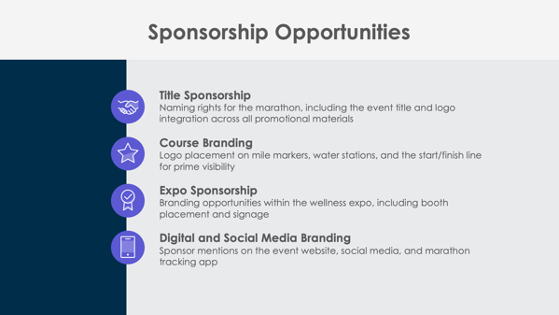
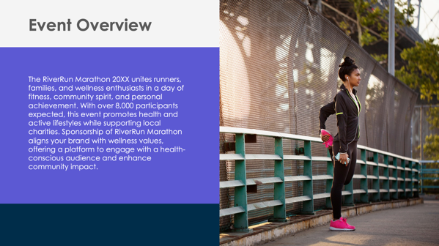
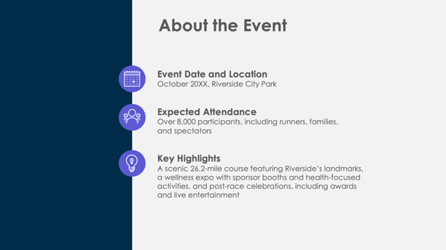
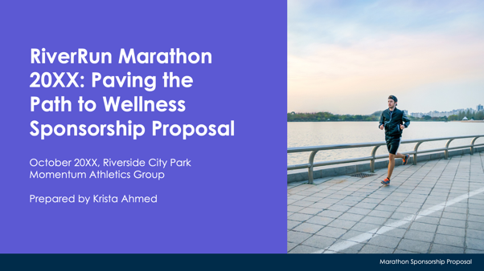
PowerPoint Marathon Sponsorship Proposal Template Example

Slide 2

RiverRun Marathon 20XX: Paving the Path to Wellness
Sponsorship Proposal
October 20XX, Riverside City Park
Momentum Athletics Group
Prepared by Krista Ahmed
EXAMPLE: Marathon Sponsorship Proposal

Slide 3
Contents
1 | Event Overview
2 | About the Event
3 | Sponsorship Opportunities
4 | Sponsorship Benefits
5 | Sponsorship Packages
6 | Custom Sponsorship Opportunities
7 | Marketing and Promotion Plan
8 | Audience Reach and Community Impact
9 | Runner and Spectator Opportunities
10 | Previous Successes and Testimonials
11 | Contact Information

Slide 4

Event Overview
The RiverRun Marathon 20XX unites runners, families, and wellness enthusiasts in a day of fitness, community spirit, and personal achievement. With over 8,000 participants expected, this event promotes health and active lifestyles while supporting local charities. Sponsorship of RiverRun Marathon aligns your brand with wellness values, offering a platform to engage with a health-conscious audience and enhance community impact.

Slide 5



About the Event
Event Date and Location
October 20XX, Riverside City Park
Expected Attendance
Over 8,000 participants, including runners, families,
and spectators
Key Highlights
A scenic 26.2-mile course featuring Riverside’s landmarks, a wellness expo with sponsor booths and health-focused activities, and post-race celebrations, including awards and live entertainment

Slide 6




Sponsorship Opportunities
Title Sponsorship
Naming rights for the marathon, including the event title and logo integration across all promotional materials
Course Branding
Logo placement on mile markers, water stations, and the start/finish line for prime visibility
Expo Sponsorship
Branding opportunities within the wellness expo, including booth placement and signage
Digital and Social Media Branding
Sponsor mentions on the event website, social media, and marathon tracking app

Slide 7
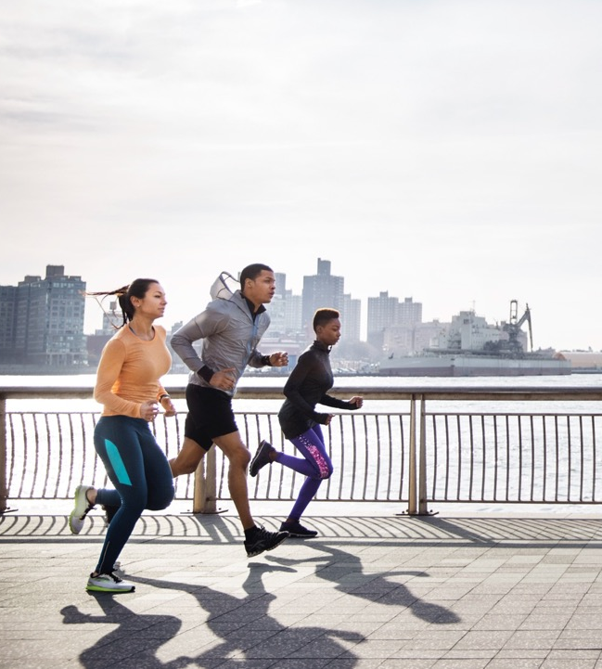
Sponsorship Benefits
Sponsors gain unparalleled brand exposure through digital platforms, in-race signage, and interactive runner engagement opportunities. By aligning with RiverRun Marathon, your brand reinforces its connection to health, fitness, and community impact. Enhanced visibility extends before, during, and after the marathon, ensuring a long-lasting brand presence.
4

Slide 8
Sponsorship Packages
Platinum Package
Title sponsorship, premium logo placement on all course markers and event materials, 40 VIP passes, a branded finish line banner, and featured media coverage
Gold Package
Prominent logo placement on water stations and participant gear, 25 VIP passes, branded merchandise giveaways, and mentions in social media promotions
Silver Package
Logo placement on the event website, 15 general admission tickets, and acknowledgment in event newsletters
Bronze Package
Logo placement in the event program, social media thank-you post, and five general admission tickets
$X,XXX
$X,XXX
$X,XXX
$X,XXX

Slide 9

Custom Sponsorship Opportunities
RiverRun Marathon 20XX offers tailored sponsorship opportunities, including branded hydration stations, sponsor-hosted warm-up areas, exclusive branded giveaways, and post-race celebration zones. These custom options give sponsors a unique platform to connect directly with runners and spectators.

Slide 10


Marketing and Promotion Plan
Pre-Event
Sponsors featured in countdown posts, targeted email campaigns, and marathon app notifications.
During Event
Real-time updates on social media, sponsor mentions during livestream coverage, and logos featured on the digital course map
Post-Event
Sponsors highlighted in recap videos, thank-you posts, and attendee follow-up emails with race results and event highlights
7

Slide 11
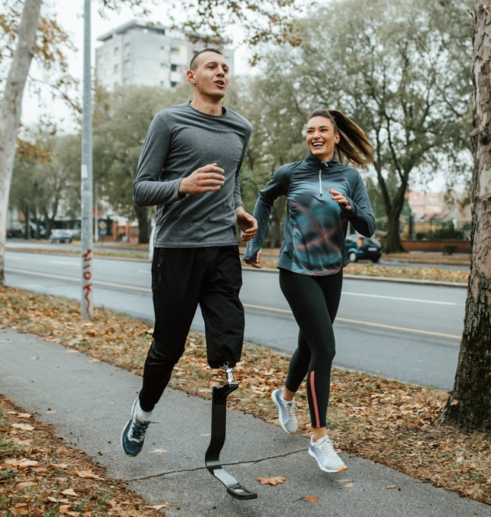

Audience Reach and Community Impact
Attendance
Over 8,000 runners and 15,000 spectators, with livestream coverage expected to reach an additional 10,000 viewers
Demographics
Primarily 18–55 years old, fitness enthusiasts, families, and wellness-focused individuals
Media Exposure
Proceeds support Riverside local charities, so sponsors will directly contribute to fostering positive community growth and goodwill

Slide 12

Runner and Spectator Engagement Opportunities
Branded Hydration Stations
Sponsor logos on water stations throughout the course, offering high visibility and direct runner interaction
Wellness Expo Booths
Sponsors can engage attendees in health-focused activities and product demonstrations
Photo Booths and Social Media Stations
Sponsor-branded areas where participants can share race-day memories online
VIP Area Sponsorship
Branding in exclusive lounges for runners, media, and key stakeholders, creating a premium presence

Slide 13
Previous Successes and Testimonials
The RiverRun Marathon has a proven track record, with
over
7,500
participants
over
50,000
media impressions
Feedback from previous sponsors includes:
“The RiverRun Marathon allowed us to connect with our ideal audience while reinforcing our commitment to wellness and community support.”
These metrics and testimonials illustrate the event’s impact and sponsor value.

Slide 14
Contact Information
Sponsorship Coordinator
Leigh Gibbs
Website
Email
momentumathletics.com
sponsorships@momentumathletics.com
Phone
Web & Social
(555) 234-5678
Follow us on Instagram, Facebook, Threads, and X for event updates.

Slide 15
DISCLAIMER Any articles, templates, or information provided by Smartsheet on the website are for reference only. While we strive to keep the information up to date and correct, we make no representations or warranties of any kind, express or implied, about the completeness, accuracy, reliability, suitability, or availability with respect to the website or the information, articles, templates, or related graphics contained on the website. Any reliance you place on such information is therefore strictly at your own risk.

