Slide 1


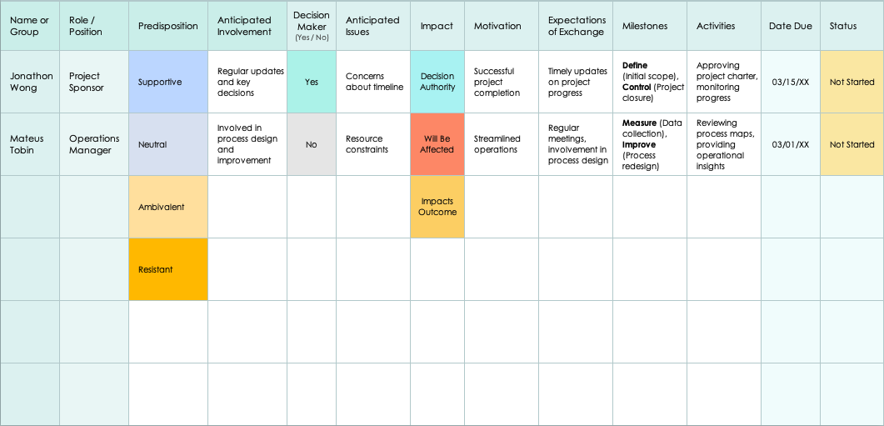
Stakeholder Analysis Template Example
Blank template begins on slide 4.

Slide 2
Stakeholder Analysis Template Example
Project Name
Process Improvement Initiative
Project Manager
Romy Bailey
Stakeholder Analysis
Date
01/01/20XX
Version
1.0.1

Slide 3
Stakeholder Analysis Template Example
Name or Group | Role / Position | Predisposition | Anticipated Involvement | Decision Maker (Yes / No) | Anticipated Issues | Impact | Motivation | Expectations of Exchange | Milestones | Activities | Date Due | Status
Jonathon Wong | Project Sponsor | Supportive | Regular updates and key decisions | Yes | Concerns about timeline | Decision Authority | Successful project completion | Timely updates on project progress | Define (Initial scope), Control (Project closure) | Approving project charter, monitoring progress | 03/15/XX | Not Started
Mateus Tobin | Operations Manager | Neutral | Involved in process design and improvement | No | Resource constraints | Will Be Affected | Streamlined operations | Regular meetings, involvement in process design | Measure (Data collection), Improve (Process redesign) | Reviewing process maps, providing operational insights | 03/01/XX | Not Started
 |  | Ambivalent |  |  |  | Impacts Outcome
 |  | Resistant

Slide 4
Project Name
Text
Project Manager
Text
Stakeholder Analysis
Date
00/00/0000
Version
1.0.1

Slide 5
Stakeholder Analysis
Name or Group | Role / Position | Predisposition | Anticipated Involvement | Decision Maker (Yes / No) | Anticipated Issues | Impact | Motivation | Expectations of Exchange | Milestones | Activities | Date Due | Status

Slide 6
Notes
Text
Stakeholder Analysis

Slide 7
DISCLAIMER Any articles, templates, or information provided by Smartsheet on the website are for reference only. While we strive to keep the information up to date and correct, we make no representations or warranties of any kind, express or implied, about the completeness, accuracy, reliability, suitability, or availability with respect to the website or the information, articles, templates, or related graphics contained on the website. Any reliance you place on such information is therefore strictly at your own risk.

