Slide 1


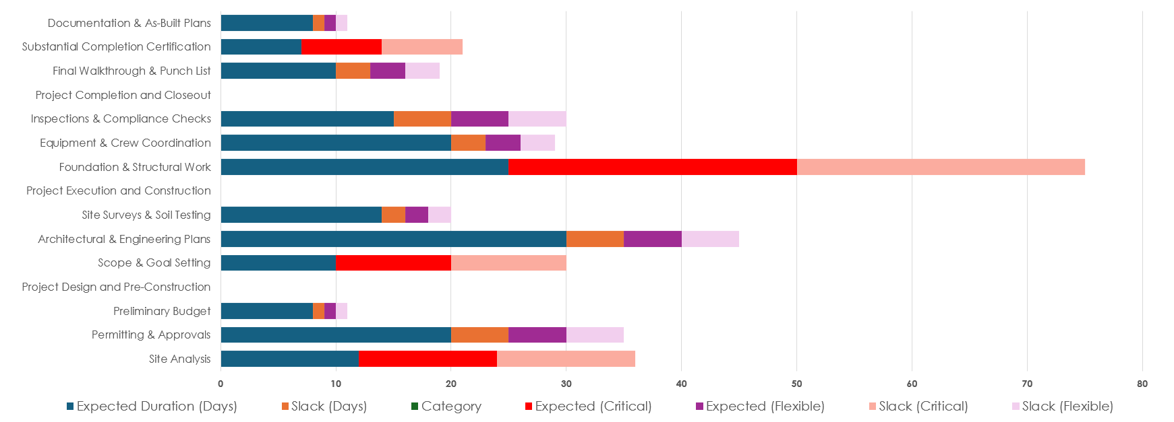
Construction Project Critical Path Dashboard Template Example
Use the Construction Project Critical Path Dashboard Template in Excel to create and populate the Critical Path chart for your dashboard. Place a screenshot on the slide to build out your presentation.

Slide 2
Example Critical Path

Slide 3
Dashboard Example
Task Name | Expected Duration (Days) | Slack (Days) | Category | Events/Milestones | Status
Project Planning and Initiation
Site Analysis | 12 | 0 | Critical | Start Site Planning | In Progress
Permitting & Approvals | 20 | 5 | Flexible | Permit Issued | On Hold
Preliminary Budget | 8 | 1 | Flexible | Budget Approved | Complete
Project Design and Pre-Construction
Scope & Goal Setting | 10 | 0 | Critical | Define Project Goals | In Progress
Architectural & Engineering Plans | 30 | 5 | Flexible | Design Finalized | Not Started
Site Surveys & Soil Testing | 14 | 2 | Flexible | Survey Completed | Complete
Project Execution and Construction
Foundation & Structural Work | 25 | 0 | Critical | Pour Foundation | Not Started
Equipment & Crew Coordination | 20 | 3 | Flexible | Resources Allocated | In Progress
Inspections & Compliance Checks | 15 | 5 | Flexible | Safety Inspection Passed | Not Started
Project Completion and Closeout
Final Walkthrough & Punch List | 10 | 3 | Flexible | Final Walkthrough Completed | Not Started
Substantial Completion Certification | 7 | 0 | Critical | Certificate Issued | On Hold
Documentation & As-Built Plans | 8 | 1 | Flexible | Final Documents Approved | In Progress

Slide 4
Use the Construction Project Critical Path Dashboard Template in Excel to create the chart for your dashboard. Place a screenshot on this slide.
Critical Path

Slide 5
Dashboard
Task Name | Expected Duration (Days) | Slack (Days) | Category | Events/Milestones | Status
Phase
Task | 0 | 0 | Critical |  | In Progress
Task | 0 | 0 | Flexible |  | On Hold
Task | 0 | 0 | Flexible |  | Complete
Phase
Task | 0 | 0 | Critical |  | In Progress
Task | 0 | 0 | Flexible |  | Not Started
Task | 0 | 0 | Flexible |  | Complete
Phase
Task | 0 | 0 | Critical |  | Not Started
Task | 0 | 0 | Flexible |  | In Progress
Task | 0 | 0 | Flexible |  | Not Started
Phase
Task | 0 | 0 | Flexible |  | Not Started
Task | 0 | 0 | Critical |  | On Hold
Task | 0 | 0 | Flexible |  | In Progress

Slide 6
DISCLAIMER Any articles, templates, or information provided by Smartsheet on the website are for reference only. While we strive to keep the information up to date and correct, we make no representations or warranties of any kind, express or implied, about the completeness, accuracy, reliability, suitability, or availability with respect to the website or the information, articles, templates, or related graphics contained on the website. Any reliance you place on such information is therefore strictly at your own risk.

