Slide 1
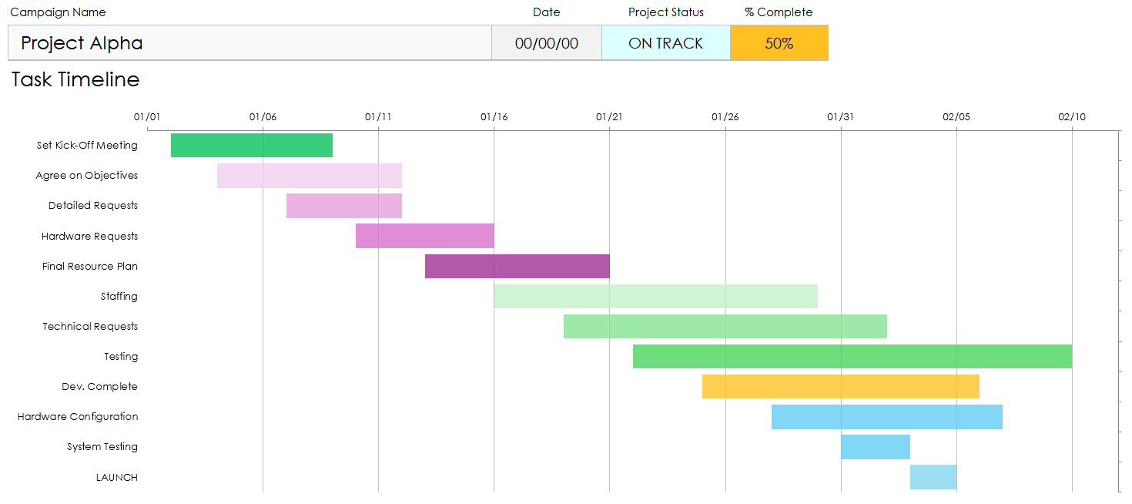
Release Plan Dashboard Template
Use the Release Plan Dashboard Template in Excel to enter data that will populate the charts and graphs for your Release Plan.
Place screenshots of each element on the following slides to build out your Release Plan Presentation.

Slide 2
Project Name
Project Dashboard
Date | Project Status | % Complete
00/00/0000 | In Progress | 72%

Slide 3
Table of Contents
1
2
3
4
5
Dashboard Overview
Dashboard Data
Task Timeline
Task Status and Task Priority
Budget and Pending Items
PROJECT REPORT

Slide 4
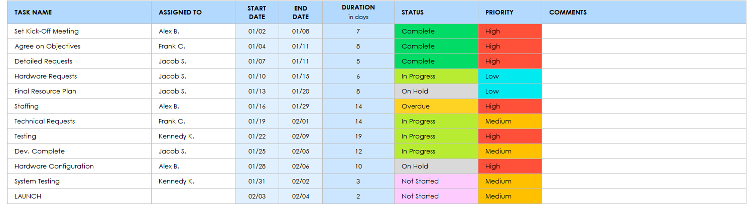
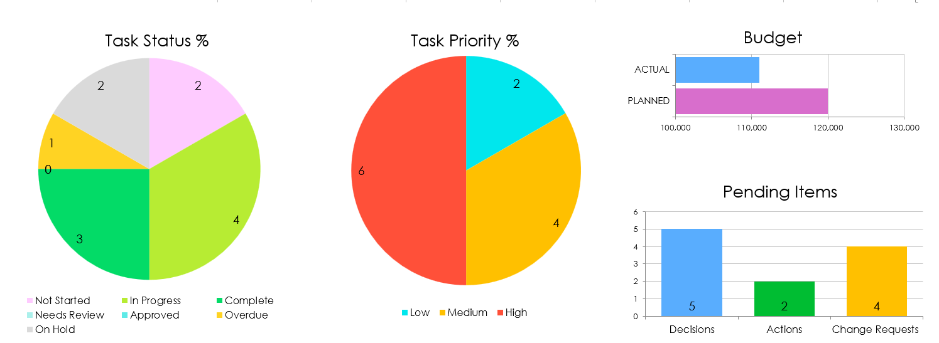
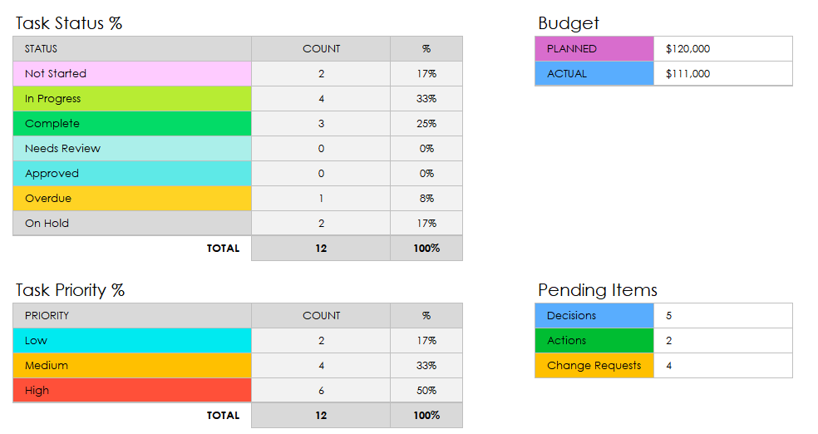
Dashboard Overview
Task Timeline
Dashboard Data
Task Priority%
Task Status
Budget
Pending Items
PROJECT REPORT

Slide 5
Dashboard Data
PROJECT REPORT

Slide 6
Dashboard Data
PROJECT REPORT

Slide 7
Task Timeline
PROJECT REPORT

Slide 8
Task Status
Task Priority
PROJECT REPORT

Slide 9
Budget
Pending Items
PROJECT REPORT
Provided by Smartsheet, Inc.

Slide 10
DISCLAIMER Any articles, templates, or information provided by Smartsheet on the website are for reference only. While we strive to keep the information up to date and correct, we make no representations or warranties of any kind, express or implied, about the completeness, accuracy, reliability, suitability, or availability with respect to the website or the information, articles, templates, or related graphics contained on the website. Any reliance you place on such information is therefore strictly at your own risk.

