Slide 1
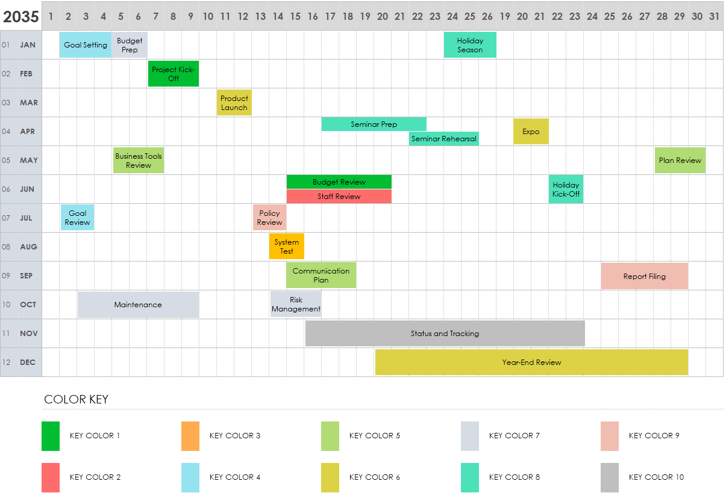
Yearly Calendar Gantt Chart Template

Slide 2
Notes for Using This Template
Complete the Color Key definitions below the chart to represent your types of activities and events.
Shade individual cells or use bars to extend across multiple days.
Enter text within each cell or bar to include additional information.
Yearly Calendar Gantt Chart Template

Slide 3
2055 |  | 1 | 2 | 3 | 4 | 5 | 6 | 7 | 8 | 9 | 10 | 11 | 12 | 13 | 14 | 15 | 16 | 17 | 18 | 19 | 20 | 21 | 22 | 23 | 24 | 25 | 26 | 27 | 28 | 29 | 30 | 31
01 | JAN
02 | FEB
03 | MAR
04 | APR
05 | MAY
06 | JUN
07 | JUL
08 | AUG
09 | SEP
10 | OCT
11 | NOV
12 | DEC
Goal Setting
Budget Prep
Holiday Season
Review
Project Kick-Off
Product Launch
Seminar Prep
Expo
Seminar Rehearsal
Business Tools Review
Plan Review
Budget Review
Holiday
Kick-Off
Staff Review
Goal
Review
Policy Review
System Test
Communication Plan
Report Filing
Maintenance
Risk Management
Status and Tracking
Year-End Review
Key Color 1
Key Color 3
Key Color 5
Key Color 7
Key Color 9
Key Color 2
Key Color 4
Key Color 6
Key Color 8
Key Color 10

Slide 4
20XX |  | 1 | 2 | 3 | 4 | 5 | 6 | 7 | 8 | 9 | 10 | 11 | 12 | 13 | 14 | 15 | 16 | 17 | 18 | 19 | 20 | 21 | 22 | 23 | 24 | 25 | 26 | 27 | 28 | 29 | 30 | 31
01 | JAN
02 | FEB
03 | MAR
04 | APR
05 | MAY
06 | JUN
07 | JUL
08 | AUG
09 | SEP
10 | OCT
11 | NOV
12 | DEC
Text
Text
Text
Text
Text
Text
Text
Text
Text
Text
Text
Text
Text
Text
Text
Text
Text
Text
Text
Text
Text
Text
Key Color 1
Key Color 3
Key Color 5
Key Color 7
Key Color 9
Key Color 2
Key Color 4
Key Color 6
Key Color 8
Key Color 10

Slide 5
DISCLAIMER Any articles, templates, or information provided by Smartsheet on the website are for reference only. While we strive to keep the information up to date and correct, we make no representations or warranties of any kind, express or implied, about the completeness, accuracy, reliability, suitability, or availability with respect to the website or the information, articles, templates, or related graphics contained on the website. Any reliance you place on such information is therefore strictly at your own risk.

