Slide 1
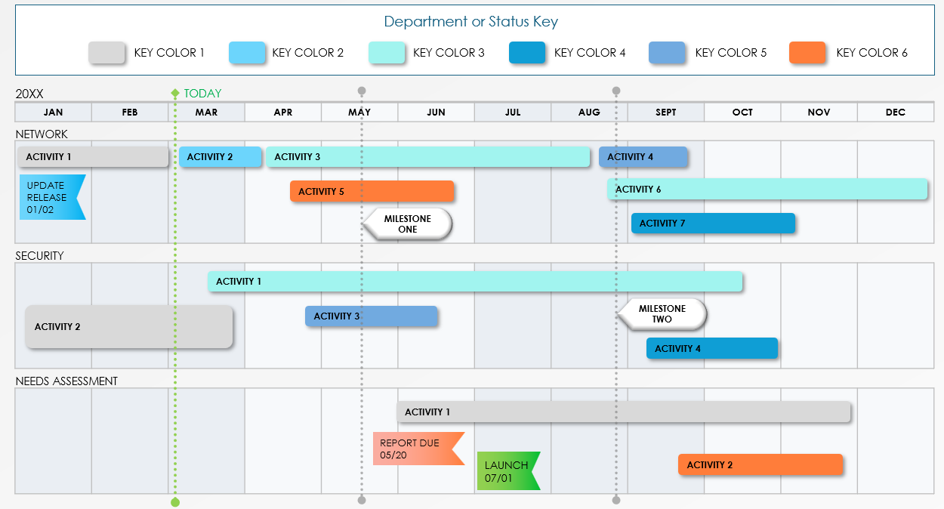
IT Project Roadmap Template
Notes for Using This Template
Enter the months and activities represented in your plan.
Adjust bars to represent the length of time per activity.
Add Start and End Dates, Milestone Dates, and additional information within each bar or in the chart area.
Use the Color Key to assign departments, team members, or status to individual activities.

Slide 2
Department or Status Key
KEY COLOR 1
KEY COLOR 2
KEY COLOR 3
KEY COLOR 4
KEY COLOR 5
KEY COLOR 6
TODAY
20XX
JAN | FEB | MAR | APR | MAY | JUN | JUL | AUG | SEPT | OCT | NOV | DEC
NETWORK
SECURITY
NEEDS ASSESSMENT
ACTIVITY 1
ACTIVITY 2
ACTIVITY 3
ACTIVITY 4
UPDATE RELEASE 01/02
ACTIVITY 5
ACTIVITY 6
MILESTONE ONE
ACTIVITY 7
ACTIVITY 1
ACTIVITY 2
ACTIVITY 3
MILESTONE TWO
ACTIVITY 4
ACTIVITY 1
REPORT DUE 05/20
LAUNCH 07/01
ACTIVITY 2
Provided by Smartsheet, Inc.

Slide 3
DISCLAIMER Any articles, templates, or information provided by Smartsheet on the website are for reference only. While we strive to keep the information up to date and correct, we make no representations or warranties of any kind, express or implied, about the completeness, accuracy, reliability, suitability, or availability with respect to the website or the information, articles, templates, or related graphics contained on the website. Any reliance you place on such information is therefore strictly at your own risk.

